Slide 1
Commercial Open Source
Product Strategies
Prof. Dr. Dirk Riehle
Friedrich-Alexander University Erlangen-Nürnberg
COSS C04
Licensed under CC BY 4.0 International
Notes:
It is Friedrich-Alexander University Erlangen-Nürnberg – FAU, in short.
Corporate identity wants us to say “Friedrich-Alexander University”.

Slide 2
Agenda
Feature differentiation
The open core model
Licensing strategies
Cloud computing challenges
Use of control mechanisms
Labor economics
Single-vendor life-cycle

Slide 3
1. Feature Differentiation

Slide 4
The Product Management Challenge (Recap)
Structure product and services so that you
  Maximize conversion to paying customer
  While benefiting from user community
  And keeping the competition at bay

Slide 5
Which Feature [1] Goes Where? (Recap)
Community edition
  Core product
    Core software
      Provided under an open source license
    Some complementary artifacts
    Self-help services
Commercial edition
  Core product
    Core software
      Provided under a commercial license
    Additional functionality
    Complementary artifacts
    Self-help services
  Basic product =
    Core product +
    Fitness for use
    Certification
    Support services
  Whole product =
    Basic product +
    Training
    Consulting
    Operations
[1] A (software) feature is a distinguishing characteristic of a software item (for example, performance, portability, or functionality) [IEEE 829]

Slide 6
A Commercial Open Source Feature Classification
Non-differentiating
  The feature is competitively not differentiating and readily available elsewhere
Reason-to-use (value creation)
  Users come to your software, because the feature is not ubiquitous
Reason-to-buy (value appropriation)
  Users upgrade to paying customers to receive this feature

Slide 7
Open / Closed Software Feature Differentiation
}
?
Other
products
Your product
(Reason-to-buy features)
Commercial open source
(Reason-to-use features)
Layers
Community open source
(Non-differentiating features)

Slide 8

How to Think About Feature Differentiation
for-pay
(closed)
Cloud
operations
at scale
Technical Domain [2]
Complementarity
free
(open)
Application
Domain [1]
Enterprise
readiness
features
Consumer
Enterprise
Market
[1] Application domain = business purpose of software = functional requirements
[2] Technical domain = support infrastructure = non-functional requirements like costs of operations

Slide 9

Yugabyte 2020 (Example Feature Differentiation)
for-pay
(closed)
yugabyte cloud
Technical Domain
Complementarity
free
(open)
Application
Domain
Consumer
Enterprise
Market

Slide 10
2. The Open Core Model

Slide 11
Intellectual Property Modularity
Intellectual property (IP) modularity
  The practice of splitting software into modules of different licenses
Open core model
  A particular form of IP modularity where there is
    An “open” core available under an open source license and
    Functional extensions of the core available only under a commercial license
C1
(license 1)
C2
(license 2)
Closed
features
Open
core

Slide 12
What do Open Core Users Worry About?
That the vendor
  Withholds critical features
  Stops updating old features
  Delays delivery of new features
  Lacks backwards compatibility

Slide 13
The Commercial Open Source Pledge
Design choices for a pledge to create trust
  Always open source or not
  Permissive or copyleft
  Allow competition or not
  Copyright transfer or not
  Support community or not
  Influence roadmap or not
[1] See https://dirkriehle.com/2019/06/11/the-commercial-open-source-pledge/

Slide 14
The Best Complement
The best complement
  Has high value to users
  Can obviously not be free

Slide 15
3. Licensing Strategies

Slide 16
The Product Management Challenge (Recap)
Structure product and services so that you
  Maximize conversion to paying customer
  While benefiting from user community
  And keeping the competition at bay

Slide 17




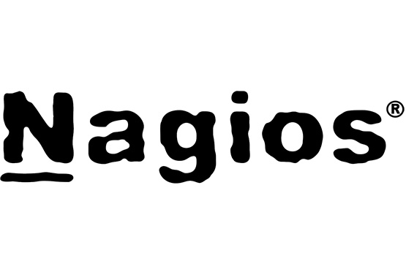

Commercial Forks of Commercial Open Source Software

Slide 18
IP Rights Management (Recap)
Intellectual property rights imperative (of single-vendor open source)
  “Always act in such a way that you, and only you, possess the right to provide the open source project under a license of your choice.” [1]
Use contributor agreement to maintain ownership
  Almost all single-vendor open source firms require copyright transfer for any contributions to maintain full IP ownership [2]
[1] Riehle, D. (2009). The Intellectual Property Rights Imperative.
[2] All you really need is a relicensing right though

Slide 19
Dual / Multi-Licensing
Dual licensing / multi-licensing
  The practice of licensing a piece of software under two or more licenses
Commercial open source licensing
  At least one open source and one commercial license
Just which open source license(s)?
  Basic idea: Use copyleft to keep competitors away

Slide 20
Product Types
Application
  A piece of software that can be used as is for a business purpose
  Example applications
    A financial accounting system
    A compiler
  Applications dominated the second wave of commercial open source
Component
  A piece of software that needs to be integrated with other components
  Example components
    Functional library
    Database system
  Components dominate the current third wave of commercial open source

Slide 21
Resulting Cloud Licensing Structures (Until About 2018)
Application
Component
MIT
commercial license
AGPLv3
commercial license
AGPLv3
MIT
1
2
1
2

Slide 22
Choice of Open Source License in Commercial Open Source
AGPLv3
APGLv3
+ shims
In-the-cloud
Deployment
AGPLv3
GPLv2
On-premise
Application
Component
Product Type

Slide 23
4. Cloud Computing Challenges

Slide 24



The Move Into the Cloud
A tectonic shift
  (Almost) everything is moving into the cloud
Open source
  Becomes an on-ramp to the cloud
Conversion is
  From self-hosted to vendor-hosted
The hyperscalers
  Are the new competition

Slide 25
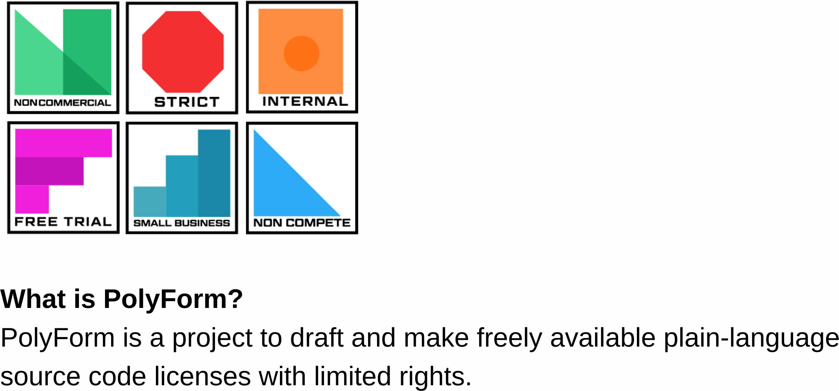
The New “Source Available” License Category
A new license category
  “Like open source, but if you want to compete with us, you are not allowed to”
Examples of new licenses
  Server Sice Public License (SSPL), introduced in 2018 by MongoDB
  Business Source License (BSL), introduced in 2016 by MariaDB
  Redis Source Available License (RSAL), introduced in 2019 by Redis Labs
The Polyform Project [1]
[1] See https://polyformproject.org/

Slide 26

The 2018 MongoDB License Change
Component | From-License | To-License
Community server | AGPLv3 (and commercial) | SSPL (and commercial)
Connectors and drivers | Apache 2.0 (and commercial) | Apache 2.0 (and commercial)
Cloud management | Commercial (only) | Commercial (only)

Slide 27



Other (Similar) Licensing Changes
Who? | What? | When? | From License | To License
 | MaxScale (Proxy Server) | 2016 | GPLv2 | BSL
 | Extensions | 2019 | Apache 2.0 | CCL
 | Extensions | 2019 | AGPLv3 | RSAL

Slide 28
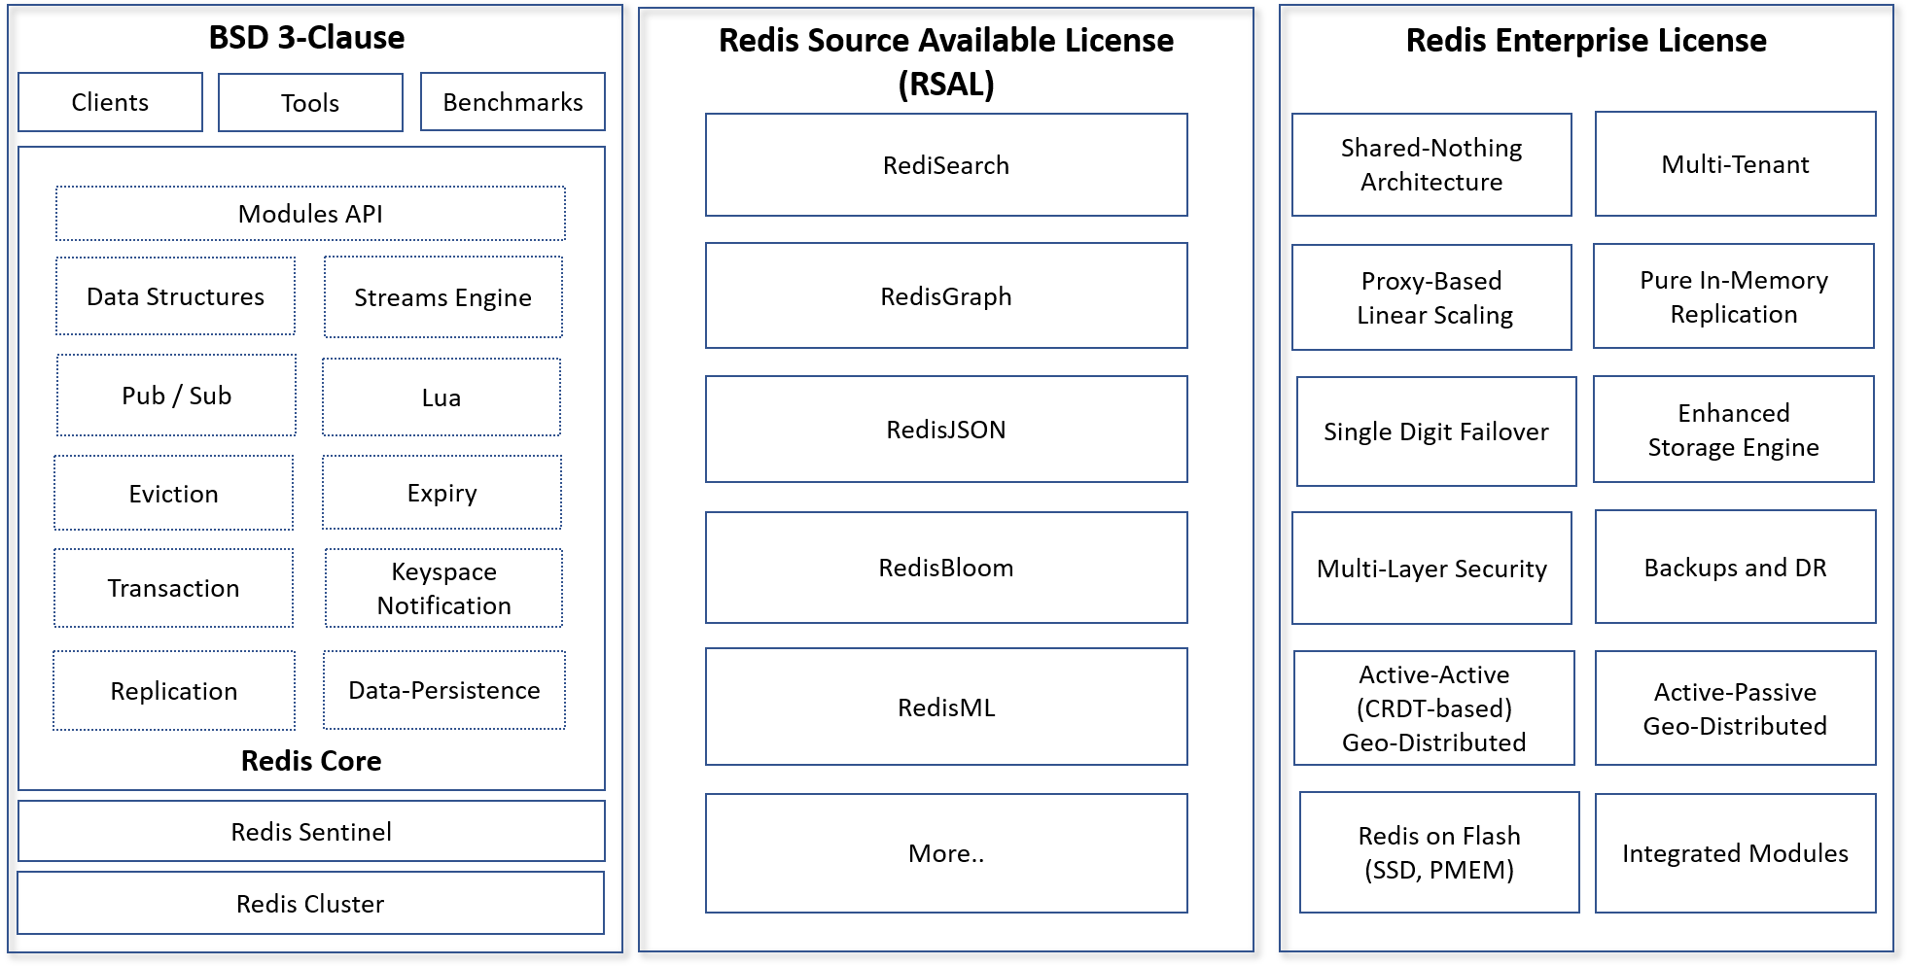
Redis After Licensing Change (AGPLv3 to RSAL) [1]
[1] https://redislabs.com/blog/redis-labs-modules-license-changes/

Slide 29
Triple-Licensing Components to Keep Competitors at Bay
Dual-Licensing
Triple-Licensing
Commercial license
Source-available license
Source-available license
Commercial license
AGPLv3
1
2
1
2
3

Slide 30
A (very) short history
5. Use of Control Mechanisms

Slide 31
Community vs. Commercial Open Source
 | Community Open Source |  | Commercial Open Source
 | Traditional | Foundation
Copyright control | Distributed | Foundation | Company
Patent ownership | Individual | Agreement | Company
Trademark control | Individual, if any | Foundation | Company
Domain ownership | Individual | Foundation | Company
Social leadership | Distributed | Distributed | Company
Committer rights | Earned | Earned | Assigned

Slide 32
6. Labor Economics

Slide 33
Position in Project = Status (Recap)
Committer
Foundation
member
explicit promotion
explicit promotion
Contributor
Project Management Committee leader
implicit promotion
explicit promotion
User
Project Management
Committee member

Slide 34
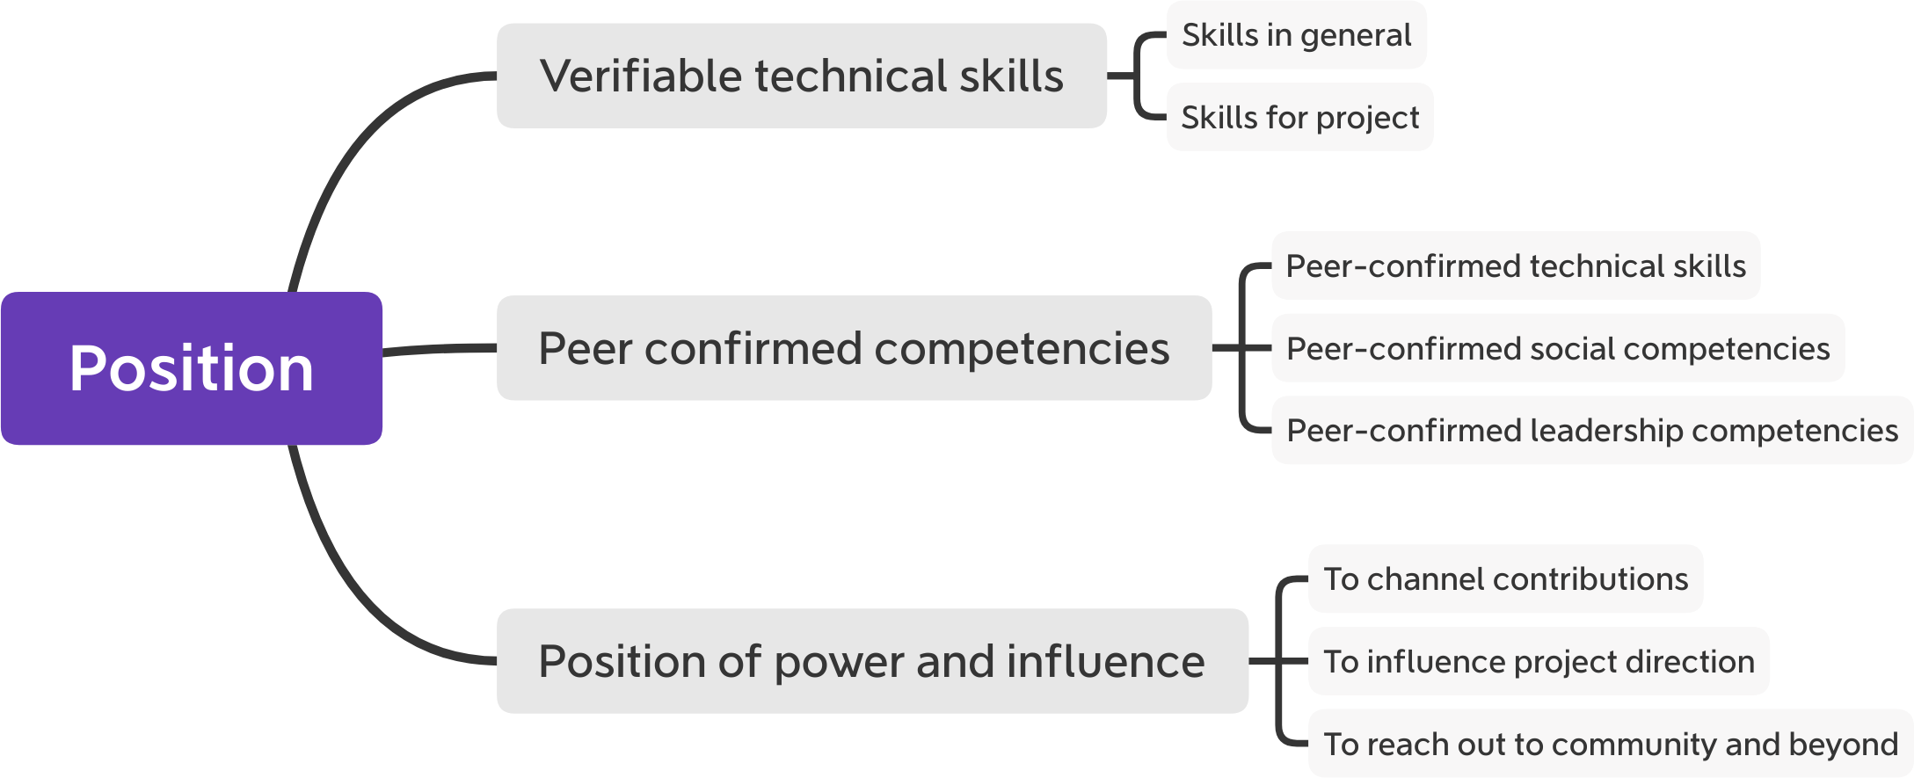
Value of Status in Open Source Project to Employers

Slide 35
Resulting Value to Developer
Better negotiation position
Higher job security
Richer job experience

Slide 36
7. The Single-Vendor Life-cycle

Slide 37
Product Life-cycle (Recap)
Maturity
Growth
Launch
Ideation and
Development
End-of-life

Slide 38
Where New Features (Innovation) Goes
Closed features
Open source code
time
Project
Inception
Problem-
solution fit
Product-
market fit
Channel-
Product fit

Slide 39
Life-cycle of Single-Vendor Firms
Early years
  Full fair open source play
Growth years
  Full fair open source play
Maturity
  Increased closing of product

Slide 40
Summary
Feature differentiation
The open core model
Licensing strategies
Cloud computing challenges
Use of control mechanisms
Labor economics
Single-vendor life-cycle

Slide 41
Thank you! Questions?
dirk.riehle@fau.de – http://osr.cs.fau.de
dirk@riehle.org – http://dirkriehle.com – @dirkriehle
DR

Slide 42
Credits and License
Original version
  © 2020 Dirk Riehle, some rights reserved
  Licensed under Creative Commons Attribution 4.0 International License
Contributions
  None yet

